Slide 1
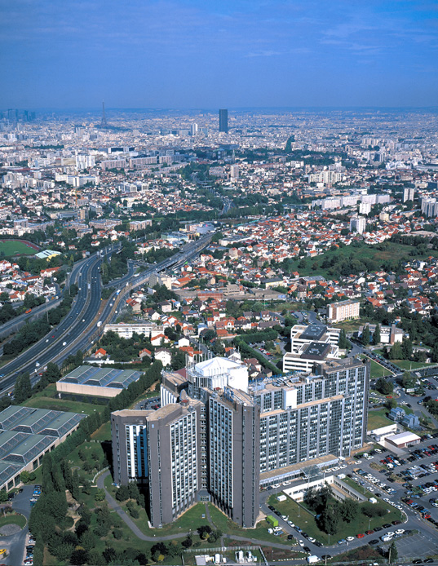
Machine & deep learning for personalized oncology
Loic Verlingue
MD Medical Oncology
PhDc Data Science

Slide 2
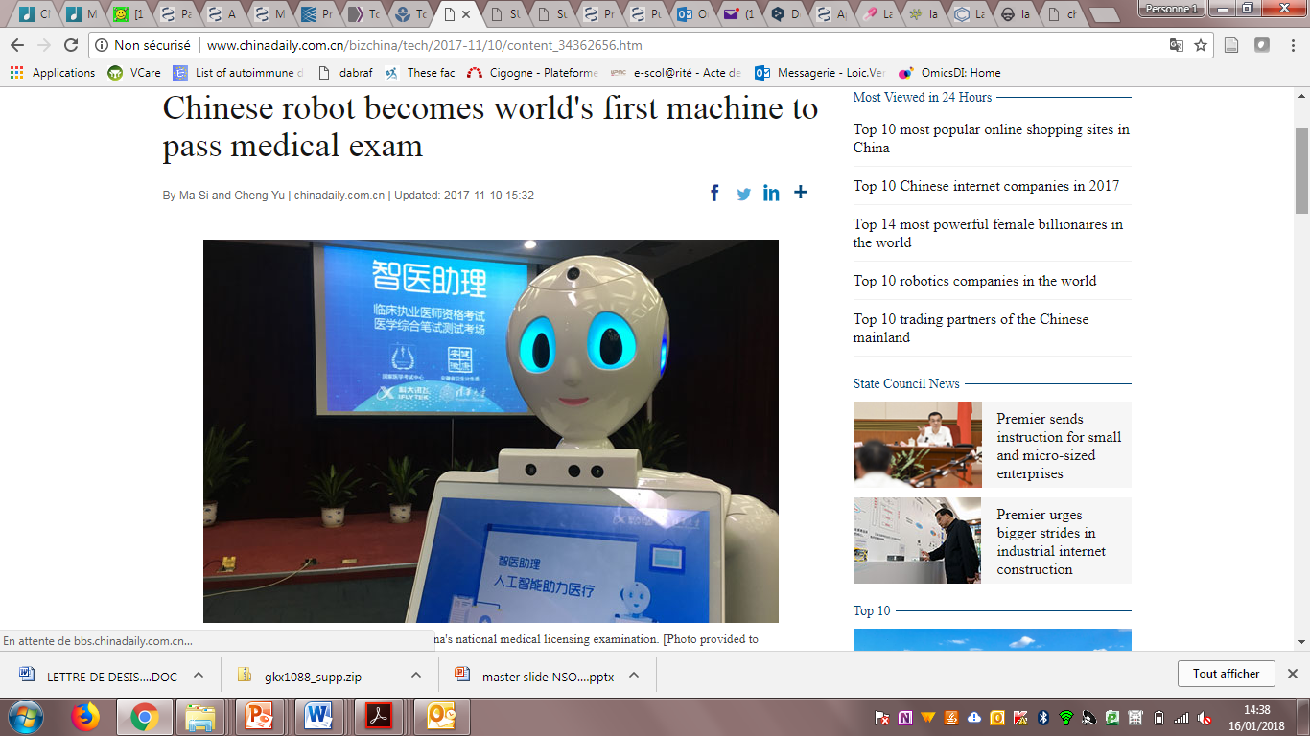
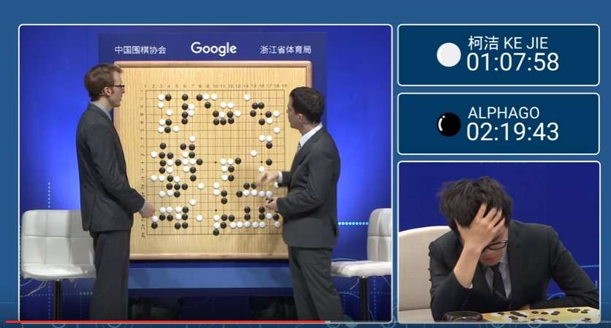

Machine learning is real: Go → Doc
?
Christophe Massard
Head DITEP

Slide 3

En médecine, les impacts réels de l’intelligence artificielle
Aller plus vite vs aller bien
Renforcer, et non remplacer, le lien patients-médecins
Des applications qui assistent les personnels de santé
Accélérer et démocratiser la recherche
De nouvelles pistes de réflexions éthiques et juridiques
Karine LEVY-HEIDMANN, decembre 2017

Slide 4
Plan
A ML / DL workflow
ML / DL is impacting
Diagnosis procedures
Drug development
Patients’ monitoring
Because of many cool things in deep learning

Slide 5
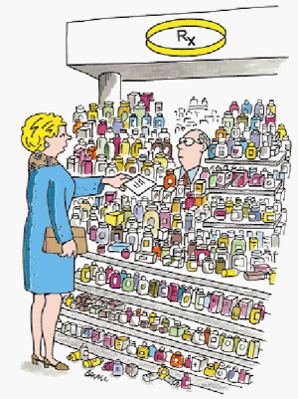
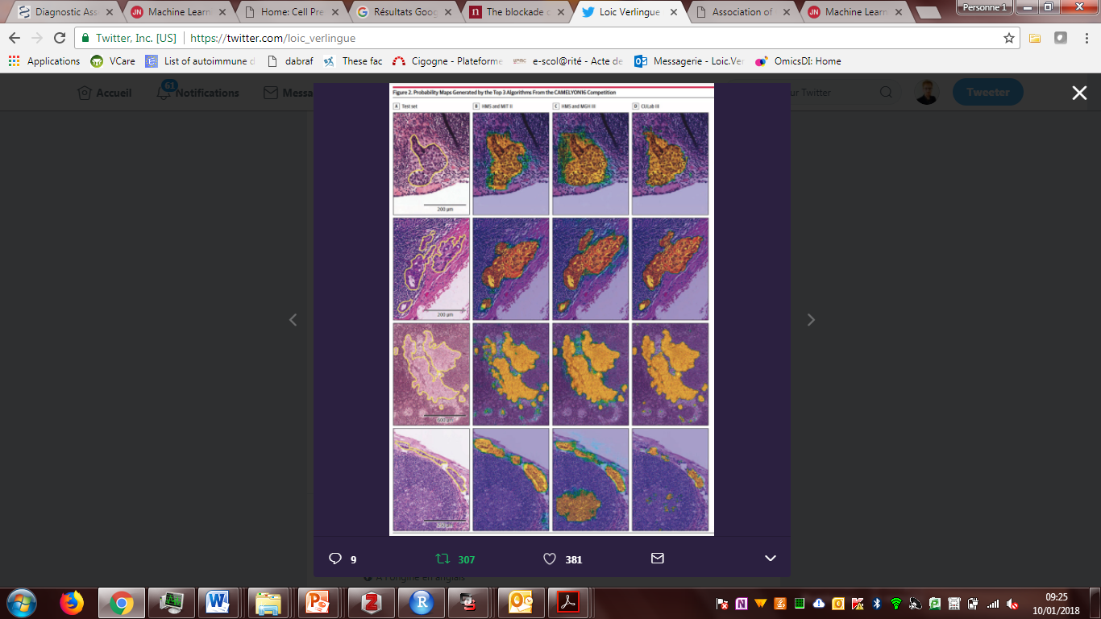

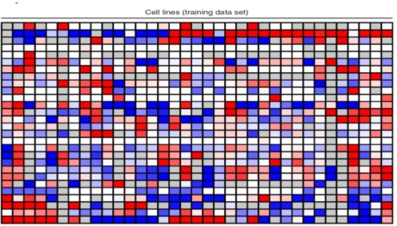
ML/DL in oncology
"Here's my sequence” The New Yorker
Molecular biology
& prognosis
Drug development
& prediction
Diagnostics
Monitoring patients

Slide 6
Machine learning workflow
Learning
Data processing
Model
Performance metric
0
Classifier
Regression
Tree-based
Neural net
1

Slide 7
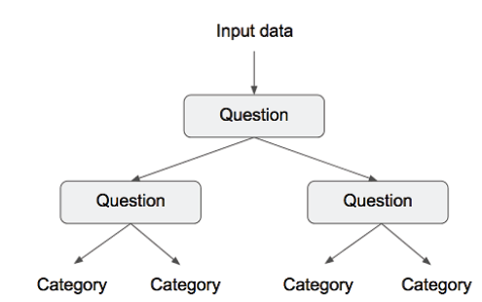
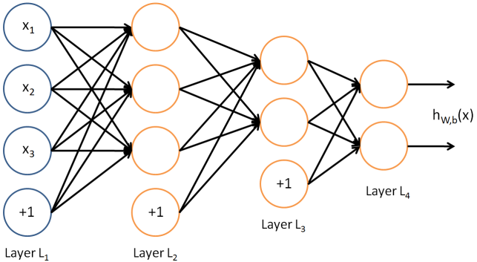
Families of models for classification
Regression /
Kernel approach eg SVM
Decision tree /
Ensemble modeling
Multi Layer Percetron = Artificial Neural Network

Slide 8

Data Processing
Learning
Data processing
Model
Performance metric
Numerical data -> ok for models
*
Natural langage data -> turn to numerical
*
Images -> use pixels values

Slide 9
Evaluation metrics
Learning
Data processing
Model
Performance metric
Comment évaluer les prédictions du modèle?

Slide 10
Métriques pour classification binaire
→ Matrice de confusion (1=SF)
→ Que préférez-vous evaluer?
 |  | Classe réelle
 |  | 0 | 1
Classe prédite | 0 | TN | FN
 | 1 | FP | TP
Notes:
Recall = tp / (tp + fn)
Le point particulier qui nous intéresse est la minimisation du nombre de Faux Négatifs

Slide 11

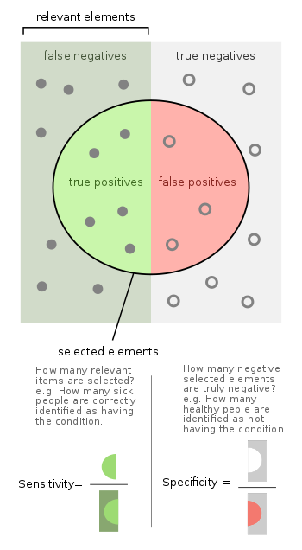
Métriques pour classification binaire
Positives
Negatives
 |  | Classe réelle
 |  | 0 | 1
Classe prédite | 0 | TN | FN
 | 1 | FP | TP
wikipedia

Slide 12
Métriques pour classification binaire
Positives
Negatives
 |  | Classe réelle
 |  | 0 | 1
Classe prédite | 0 | TN | FN
 | 1 | FP | TP
wikipedia

Slide 13
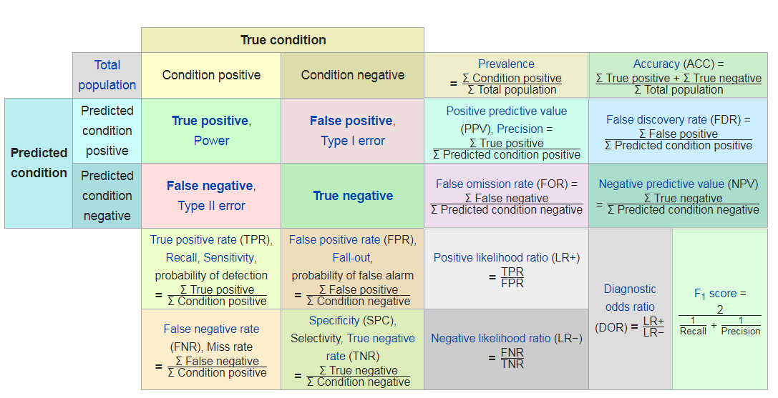
Métriques pour classification binaire
wikipedia

Slide 14
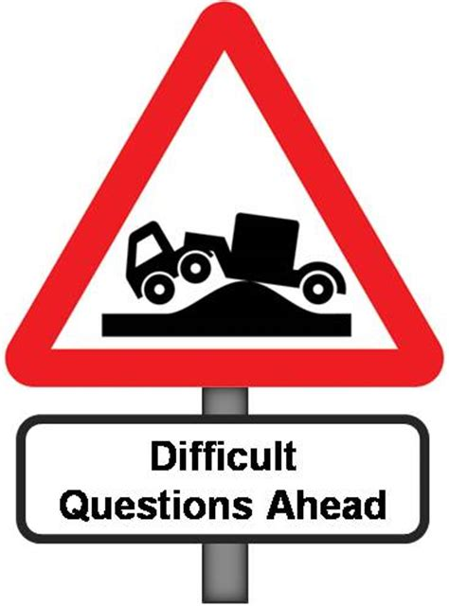
Quelle méthode d’apprentissage ?
Learning
Data processing
Model
Performance metric

Slide 15
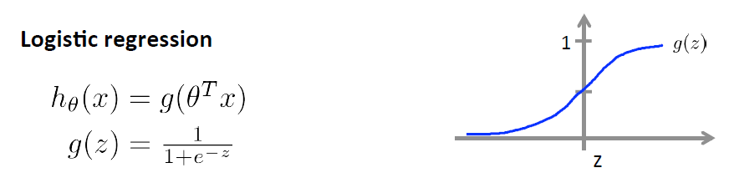

Probability to belong to a class
with a sigmoid function
Ok for:
Regression /
Kernel approach eg SVM
Multi Layer Percetron = Artificial Neural Network

Slide 16
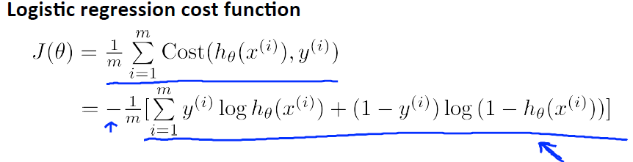
Calculate the cost / error
prediction
h(x)=
truth
If y=1
If y=0
0
h(x)
1
0
h(x)
1

Slide 17
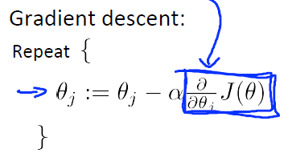
Parameters’ updates with gradient descent
Compute the cost
Derivative of the cost
Parameters’
updates
Learning rate

Slide 18
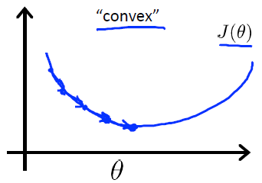
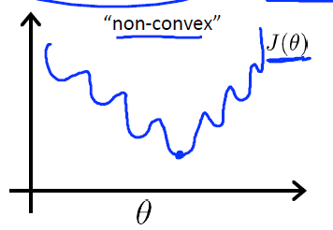
Optimisation of the cost
Best fit!
?
Updates with gradient descent
Figures from Andrew Ng Coursera

Slide 19
Etes vous sûr que les futurs exemples seront bien prédits?

Slide 20
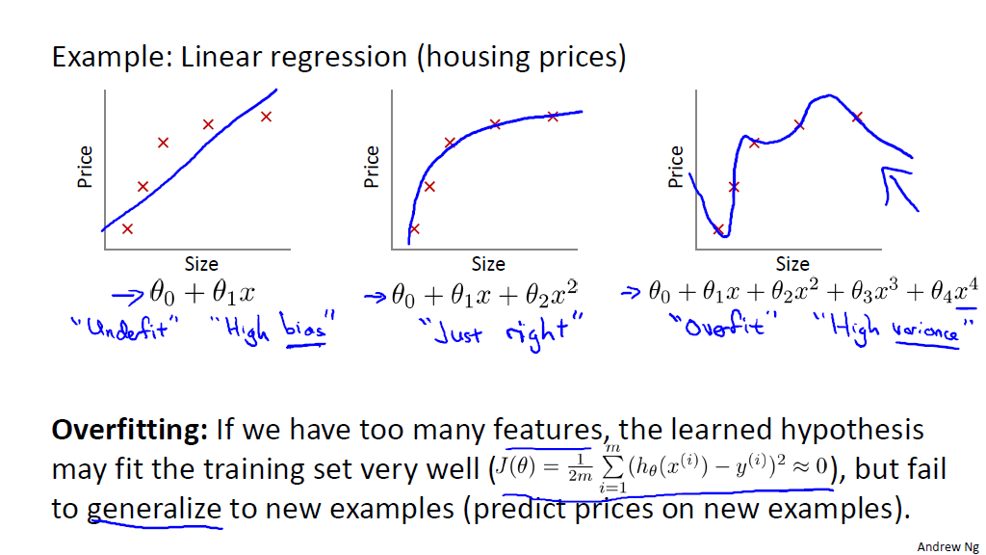
Généralisation du modèle
Biais
Variance

Slide 21
The problem of overfitting
One solution: increase observations
Other solutions: penalize the learning
constrain the model

Slide 22
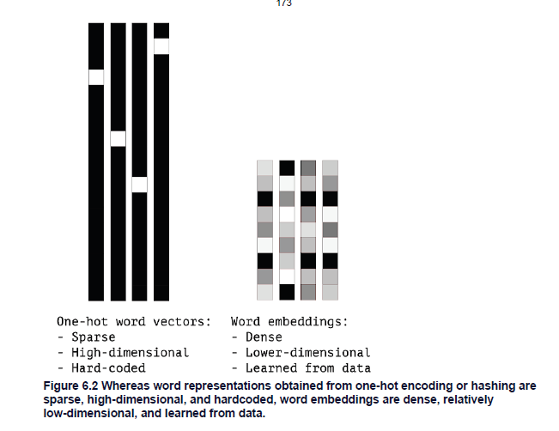
ML generalization testing workflow
split
 |  | Classe réelle
 |  | 0 | 1
Classe prédite | 0 | 141 | 11
 | 1 | 28 | 56
train
Examples
Evaluate generalizability
Variables
 |  | Classe réelle
 |  | 0 | 1
Classe prédite | 0 | 25 | 1
 | 1 | 2 | 14

Slide 23
ML/DL in oncology
"Here's my sequence” The New Yorker
Molecular biology
& pronostic
Drug development
& prediction
Diagnostics
Monitoring patients

Slide 24
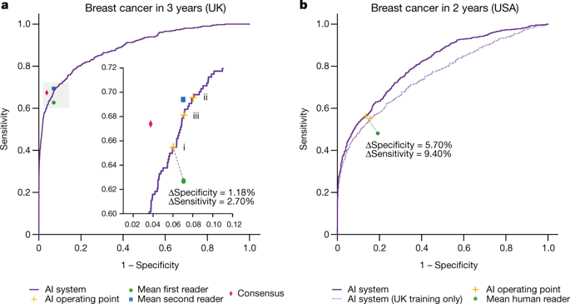
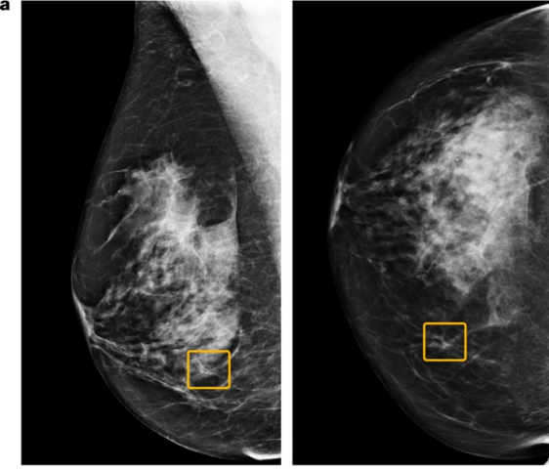
Breast cancer screening
International evaluation of an AI system for breast cancer screening, Scott Mayer McKinney, Marcin Sieniek, […]Shravya Shetty, Nature volume 577, pages89–94(2020)

Slide 25
Main Objective | Tumor type | Image Modality | Number of data points (training set + validation/test set) | Endpoints and results | Reference
Diagnosis | Lung cancer | Low dose CT-scan | 102 + 70 | Prediction of malignancy in lung nodules. Accuracy: 70-77% | Liu et al., 2016⁵
Diagnosis | Lung cancer | CT-scan | 312 + 288 | Malignant nodules accuracy: 80% Benign nodules accuracy: 79% | Hawkins et al., 2016⁶
Diagnosis | Lung ADK | CT-scan | 54 + 86 | Correlation with invasive versus non-invasive adenocarcinomas: Spearman R = 0.87-0.89 (p<0.0001) | Maldonado et al., 2013⁷
Diagnosis | NSCLC | CT-scan | 81 + 48 | Distinguish ADK versus SCC: AUC=0.893-0.905 | Zhu et al., 2018⁸
Diagnosis | NSCLC | CT-scan | 160 + 235 | Discrimination between invasive and non-invasive ADK: Accuracy 84.0-90.8% | Fan et al., 2018⁹
Diagnosis | Prostate Cancer | MRI | 54 + 0 | Radiomics model for cancer diagnosis: AUC=0.955 | Wang et al., 2017¹⁰
Diagnosis | Prostate Cancer | MRI | 147 + 0 | Benign versus malignant lesions: Accuracy 93% | Fehr et al., 2015¹¹
Molecular characterization | Breast Cancer | MRI | 91 + 0 | Radiomics features used to predict molecular subtypes, AUC: 0.65-0.89 | Li et al., 2016¹²
Molecular characterization | Breast cancer | MRI | 48 + 0 | Significant correlation between radiomics features and luminal B subtype (p=0.0015) | Mazurowski et al., 2014¹³
Molecular characterization | Breast cancer | MRI | 461 + 461 | Prediction of molecular subtype: Luminal A, AUC=0.697 TNBC, AUC=0.654 ER status, AUC=0.649 PR status, AUC=0.622 | Saha et al., 2018¹⁴
Molecular characterization | NSCLC | PET-CT | 26 + 0 | Association with gene expression pathways with an accuracy ranging from 59% - 83% | Gevaert et al., 2012¹⁵
Molecular characterization | Lung ADK | CT-scan | 385 + 0 | Prediction of EGFRm status with combination of radiomics signature and clinical variables: AUC=0.778 | Liu et al., 2016¹⁶
Molecular characterization | GBM | MRI | 23 + 0 | Correlation of radiomics features with multiple molecular pathways | Jamshidi et al., 2014¹⁷
Molecular characterization | GBM | MRI | 22 + 110 | Significant associations with tumor hypoxia (p=0.012); proliferation gene-expression signature (p=0.0017); EGFR protein overexpression (p<0.002) | Diehn et al., 2008¹⁸
Molecular characterization | HNSCC | PET-CT + CT-scan | 42 + 79 | Correlation with hypoxia: AUC=0.755-0.833 Hypoxia measured by ¹⁸F-FMISO PET-CT | Crispin-Ortuzar et al., 2018¹⁹
Molecular characterization | CRC | CT-scan | 61 + 56 | Radiomics signature predicts: KRAS mutation, AUC=0.829-0.869 NRAS mutation, AUC=0.757-0.686 BRAF mutation, AUC=0.833-0.857 | Yang et al., 2018²⁰
Molecular characterization | Rectal cancer | MRI | 114 + 0 | pCR diagnosis after neo-adjuvant treatment : AUC=0.93 | Horvat et al., 2018²¹
Prognosis | NSCLC & HNSCC | CT-scan | 474 + 545 | Radiomics signature correlates with stage and OS: NSCLC CI=0.65 HNSCC CI=0.69 | Aerts et al., 2014²²
Prognosis | Lung ADK | CT-scan | 98 + 84 | Risk of metastases relapse CI=0.61 | Coroller et al., 2015²³
Prognosis | NSCLC | CT-scan | 22 + 0 | Recurrence prediction based on post-treatment imaging: Accuracy 73-77% | Mattonen et al., 2015²⁴
Prognosis | NSCLC | PET-CT | 70 + 31 | Risk of distant metastasis: CI=0.71 When combining with histologic type: CI=0.80 | Wu et al., 2016²⁵
Prognosis | GBM | MRI | 79 + 40 | Prognosis OS (p=0.001) | Kickingereder et al., 2016²⁶
Prognosis | GBM | MRI | 121 + 60 | Prognosis prediction errors decreased 36% for PFS and 37% for OS compared to clinical features alone | Kickingereder et al., 2018²⁷
Prognosis | GBM | MRI | 126 + 165 | Significant stratification for OS (p=0.001) and PFS (p=0.000021) | Grossman et al., 2017²⁸
Prognosis | Colorectal cancer | CT-scan | 326 + 200 | Lymph node metastasis prediction: CI=0.78 | Huang et al., 2016²⁹
Prognosis | Nasopharyngeal carcinoma | MRI | 88 + 30 | Radiomics signature associated with PFS: CI=0.761 | Zhang et al., 2018³⁰
Prognosis | Breast Cancer | MRI | 84 + 0 | Prediction of risk recurrence concordance as assessed by PAM50 or Mammaprint: AUC=0.55-0.88 | Li et al., 2016³¹
Prognosis | Breast Cancer | MRI | 92 + 54 | Sentinel lymph node metastasis based on radiomics features of pre-operative MRI: AUC=0.770-0.863 | Dong et al., 2018³²
Prognosis | Breast cancer | MRI | 194 + 100 | Radiomic signature correlate with DFS: p=0.002 in the training set P=0.036 in the validation set | Park et al., 2018³³
Prognosis | High-grade osteosarcoma | CT-scan | 102 + 48 | OS prognosis: AUC=0.73-0.86 | Wu et al., 2018³⁴
Treatment effect | NSCLC | PET-CT | 47 + 0 | Correlation of radiomics features with treatment response (p=0.01) | Cook et al., 2015³⁵
Treatment effect | NSCLC EGFRm | CT-scan | 117 + 197 | Radiomics signatures discriminating between rapid and slow progression with EGFR TKIs: HR=3.61-3.77 | Song et al., 2018³⁶
Treatment effect | GBM | MRI | 112 + 60 | Anti-angiogenic treatment response predictor, separation into low- and high-risk groups, significant for PFS (p<0.001) and OS (p=0.001) | Kickingereder et al., 2016³⁷
Treatment effect | Breast cancer | MRI | 78 + 39 | pCR after neo-adjuvant treatment: radiomics features alone, AUC=0.74-0.78 radiomics and molecular features, AUC=0.83-0.93 | Braman et al., 2017³⁸
Treatment effect | Rectal cancer | MRI | 48 + 0 | Radiomic features predict response do neo-adjuvant therapy: AUC=0.71-0.79 | Nie et al., 2016³⁹
Treatment effect | RCC | CT-scan | 39 + 0 | Response to tyrosine kinase inhibitors prediction and time to progression prediction: AUC=0.71 | Goh et al., 2011⁴⁰
Treatment effect | All tumor types | CT-scan | 137 + 0 | Response to anti-PD-(L)1 therapy: objective response, p=0.025 improved OS, p=0.0022 Also, able to discriminate CD8 infiltration | Sun et al., 2018⁴¹
Many others

Slide 26
ML/DL in oncology
"Here's my sequence” The New Yorker
Molecular biology
& pronostic
Drug development
& prediction
Diagnostics
Monitoring patients

Slide 27
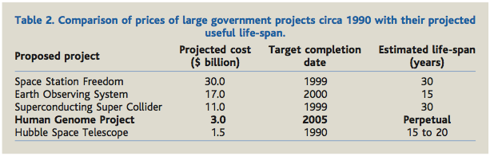
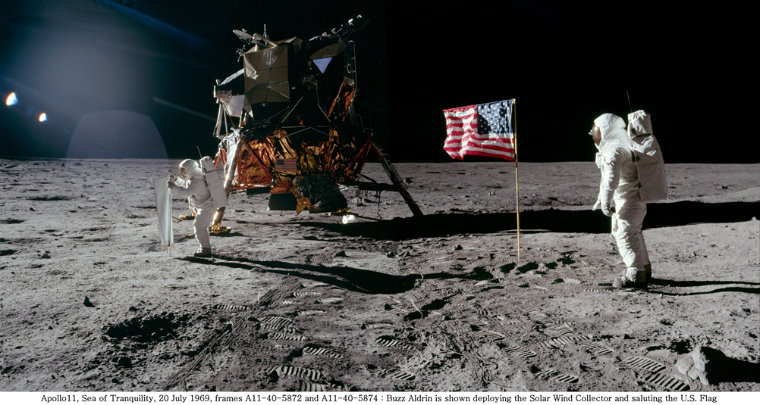
Molecular biology & genetics
Collins et al, Science 2003

Slide 28
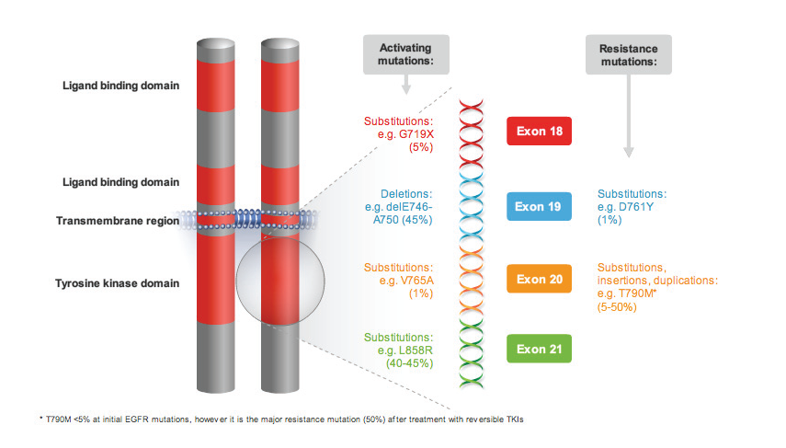
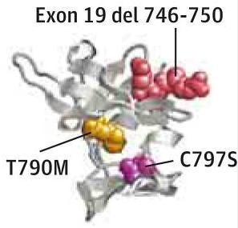
Example of lung adk
EGFR treamtent and resistance mechanisms
Courtesy of L. Mahjoubi
Oxnard et al. Nat Med 2016

Slide 29
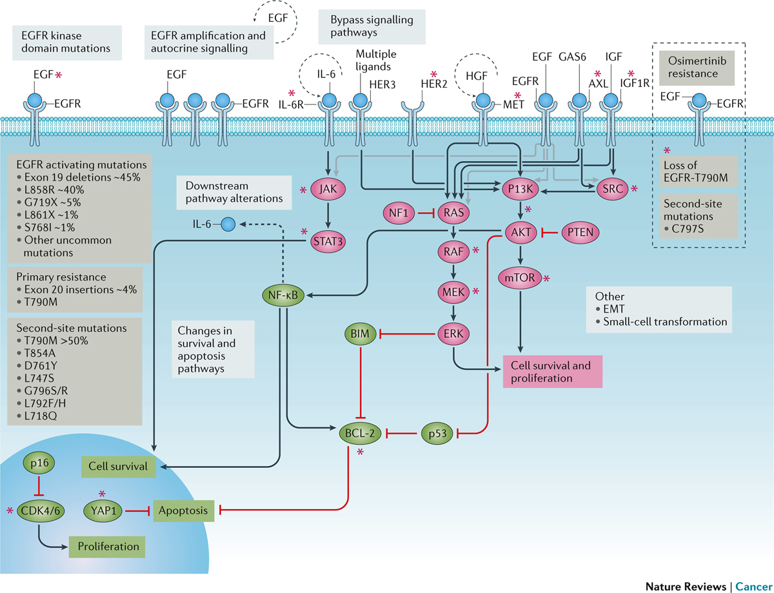
EGFR treamtent and resistance mechanisms
Understanding and targeting resistance mechanisms in NSCLC, Julia Rotow, Trever G. Bivona, Nature review cancer, 2017 oct

Slide 30
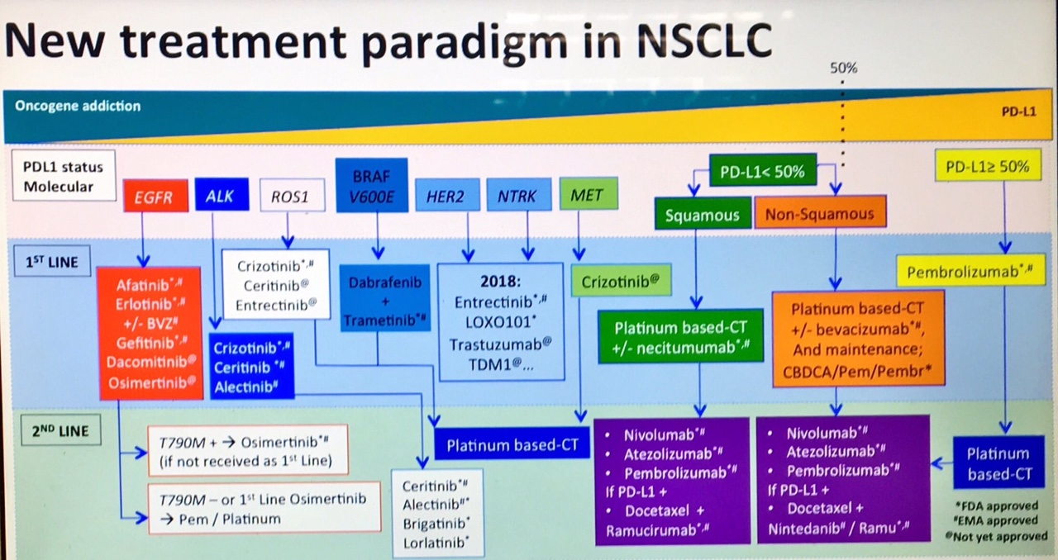
Courtesy Dr Jordi Remon

Slide 31
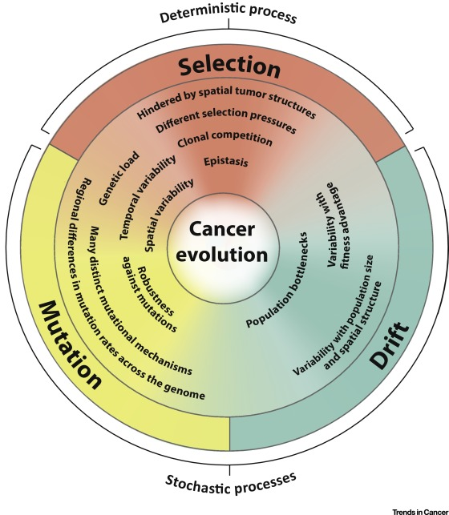
Cancer Evolution
Time
Lipinski KA, Barber LJ, Davies MN, Ashenden M, Sottoriva A, Gerlinger M. Cancer Evolution and the Limits of Predictability in Precision Cancer Medicine. Trends Cancer. 2016 Jan

Slide 32
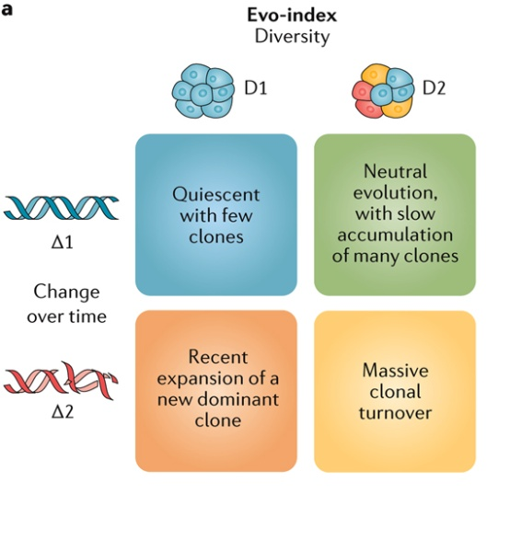
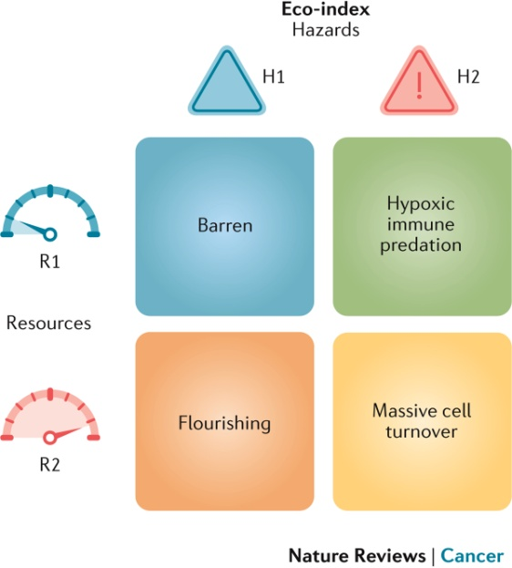
Evolutionary and ecological features of neoplasms
Maley CC, et al. Classifying the evolutionary and ecological features of neoplasms. Nat Rev Cancer. 2017 Oct

Slide 33
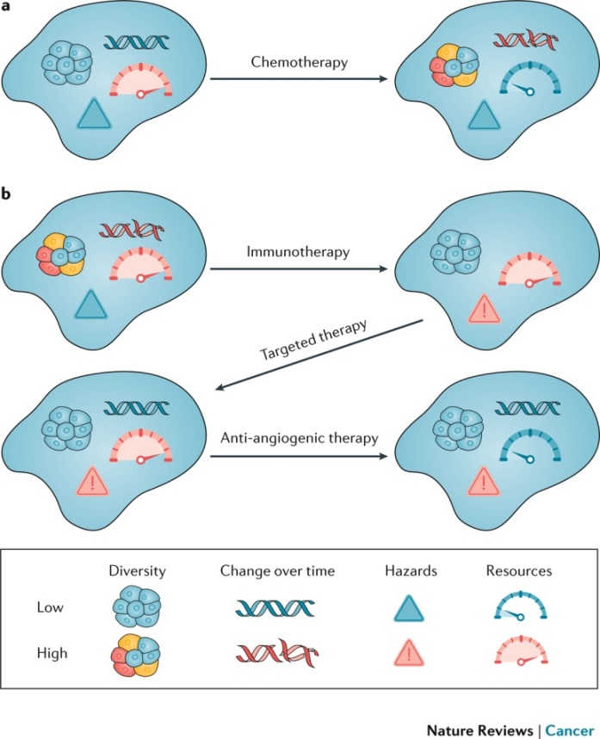
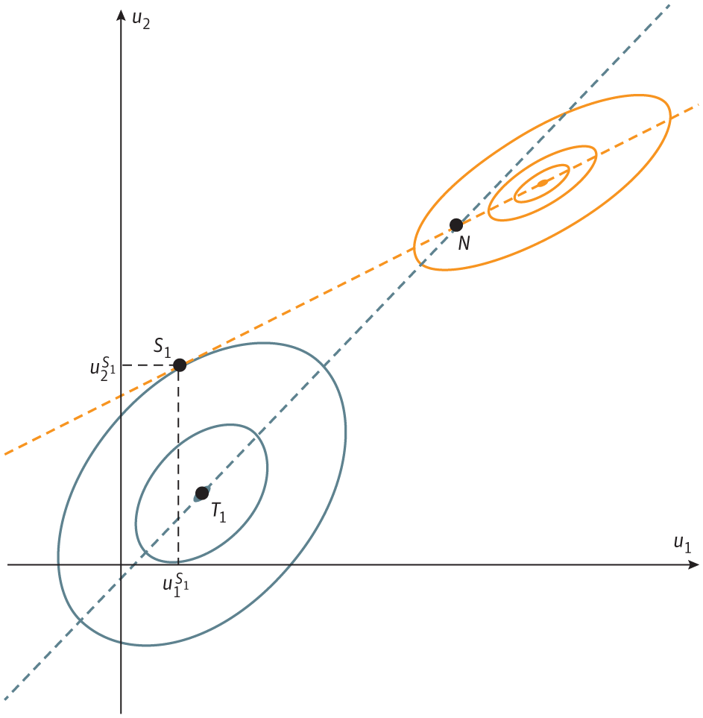
Cancer evolution -> game theory
Pursuit : escape
Treatment : tumor cells
model
Maley CC, et al. Classifying the evolutionary and ecological features of neoplasms. Nat Rev Cancer. 2017 Oct
Stanková K et al. Optimizing Cancer Treatment Using Game Theory: A Review. JAMA Oncol. 2018

Slide 34
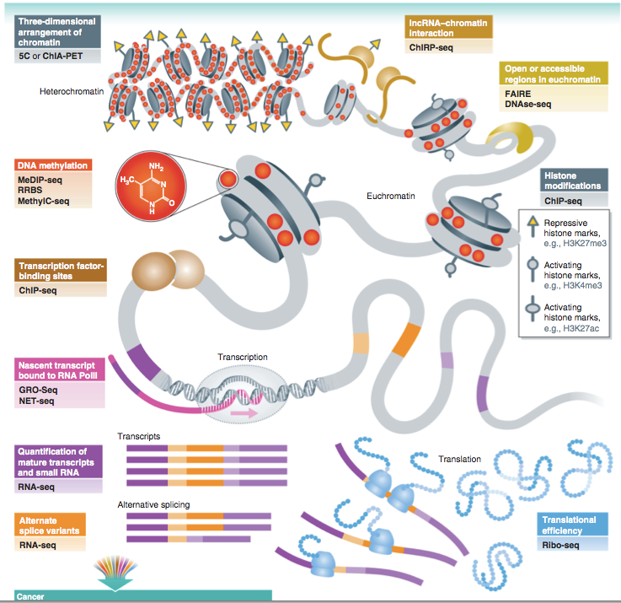
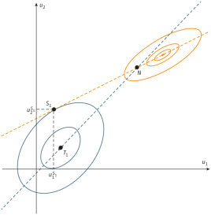
Complexity
Cancer/patient selection
model
prediction
WW Soon et al. 2013

Slide 35
Cancer/patient selection
Models
model
prediction

Slide 36

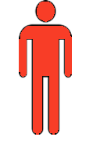
The patient & his tumor’s biology
treatment
diagnosis
PFS
OS

Slide 37
What do we expect from models?
treatment
diagnosis
model
PFS
In vitro models
model
Prevention
Prediction
OS
model
model
Prognosis
=3P + Personalization!
model

Slide 38
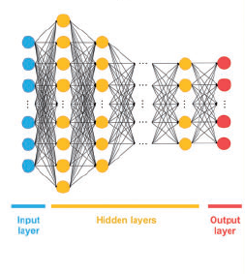
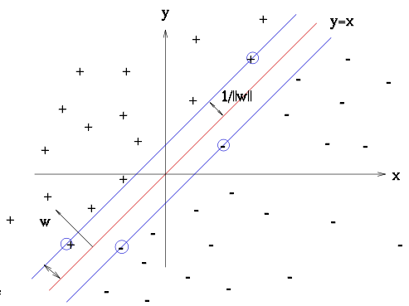

The models you have
Human
Statistics
Deep learning
Use your knowledge and reasoning
Linear models easy to
explain
Non-linear models data-expensive
Cox model
logReg eg: RMH
Examples:
Christophe Massard
Deep neural network
Notes:
capacité des algorithmes d'apprentissage profond à construire des caractéristiques complexes d'une manière hiérarchique, en apprenant les relations et la structure au sein des données brutes

Slide 39
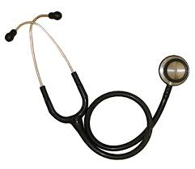
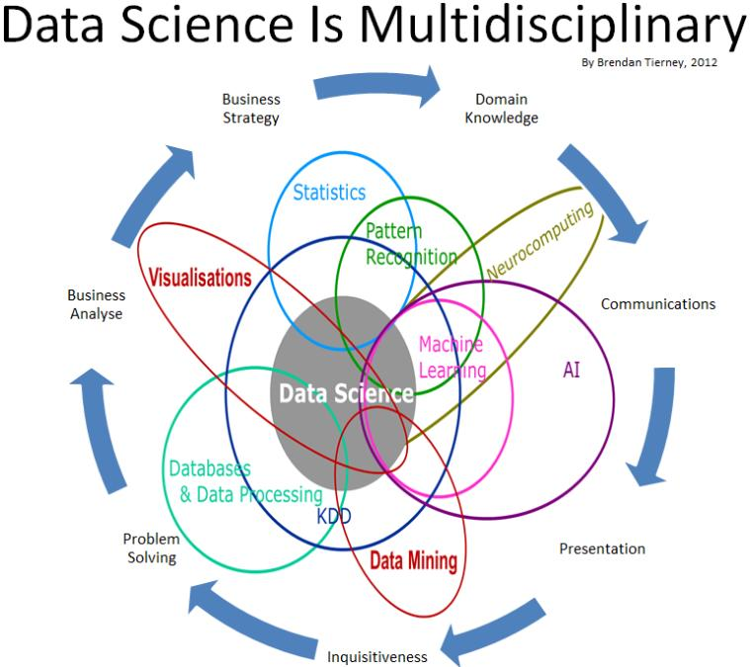
Cancer/patient selection
The tools you need
+

Slide 40
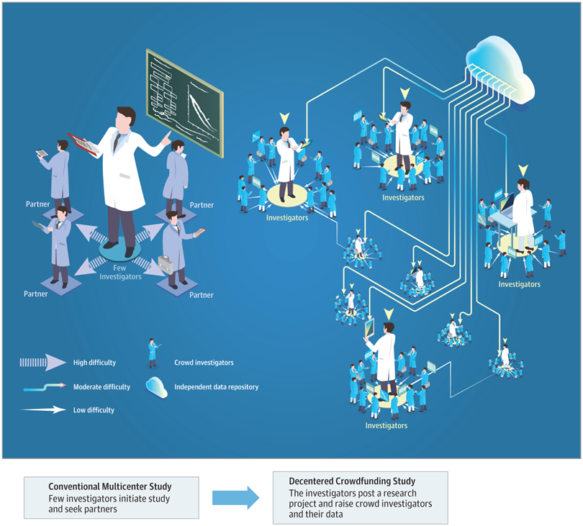
The organization you need
Yu H, Luo Y. Decentered Crowdfunded Clinical Studies-Open a New Era of Medical Research. JAMA Oncol. 2018 Oct 18. doi: 10.1001/jamaoncol.2018.4650. [Epub ahead of print] PubMed PMID: 30347009.

Slide 41
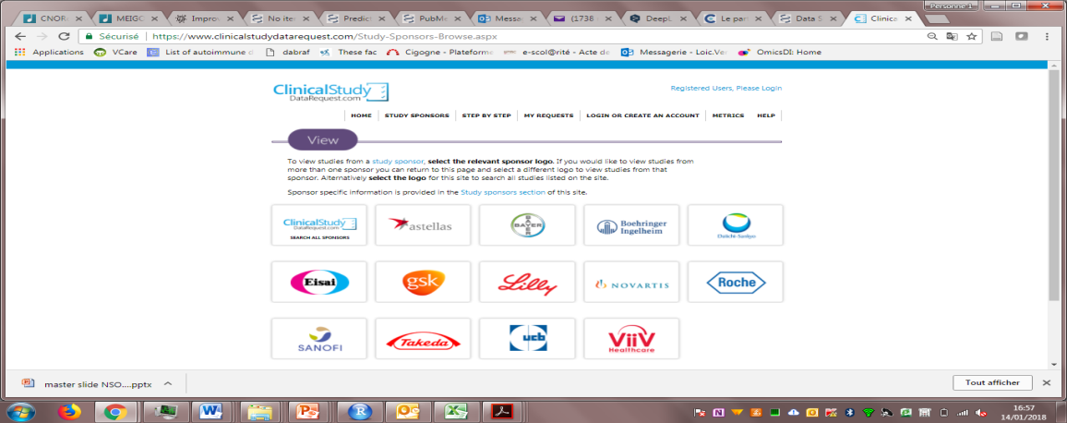

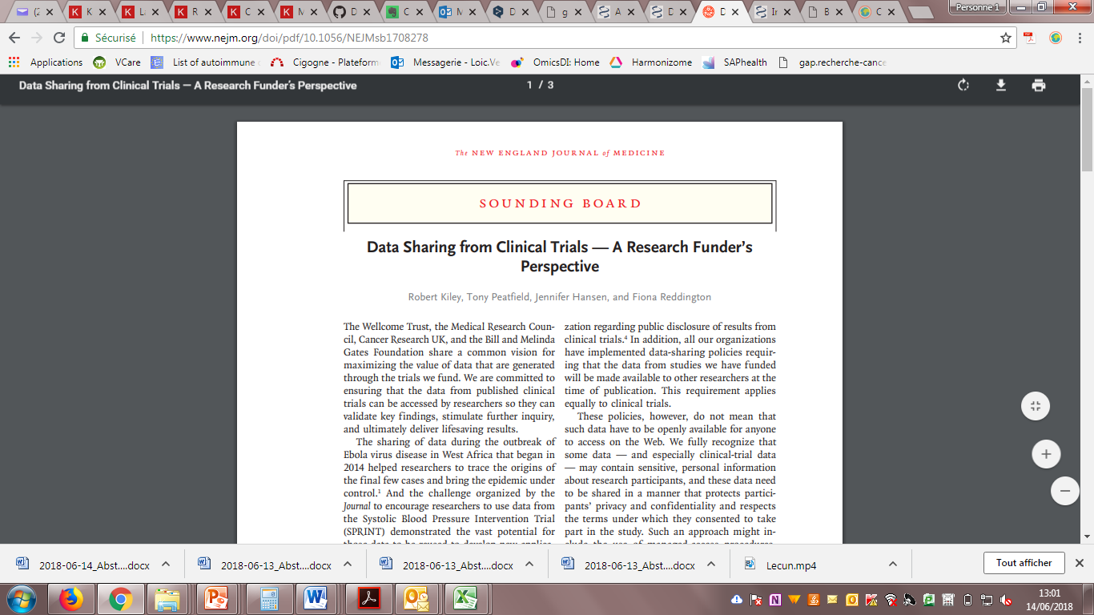
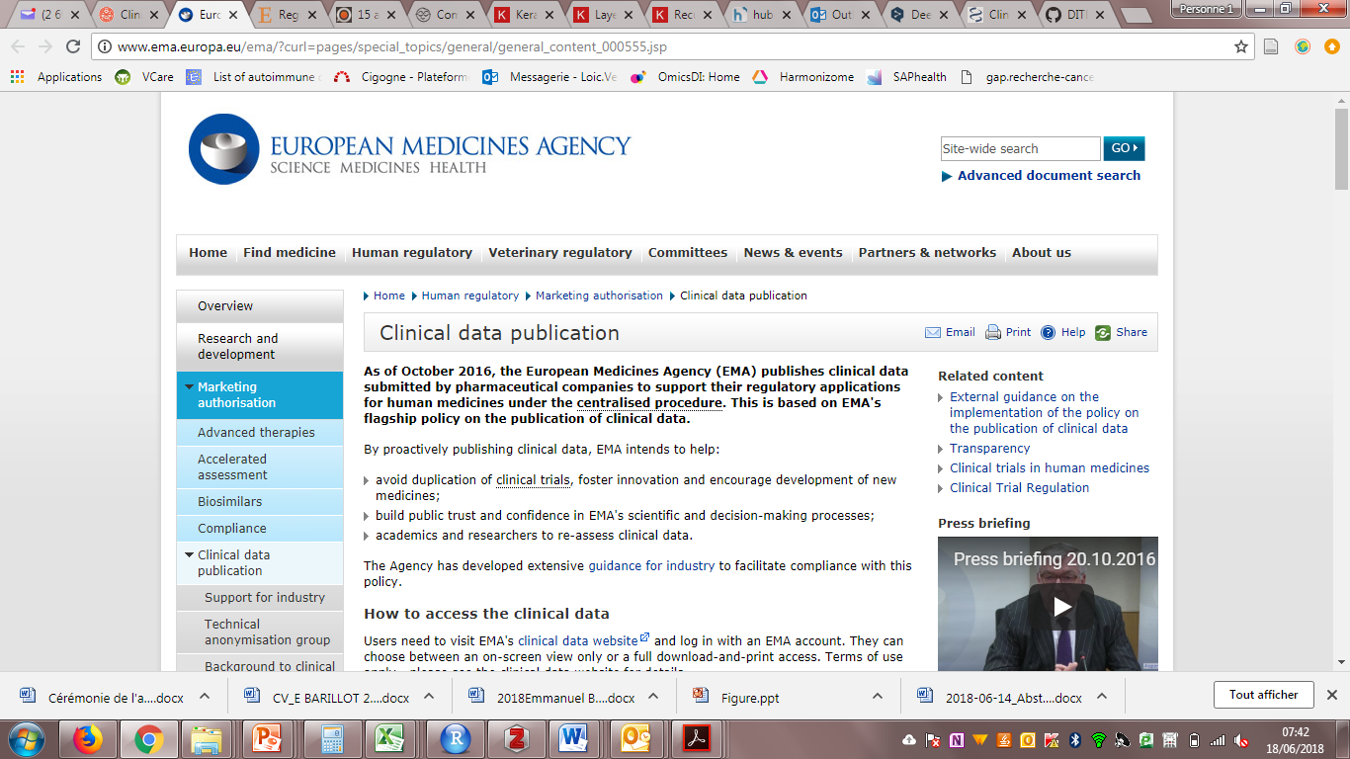
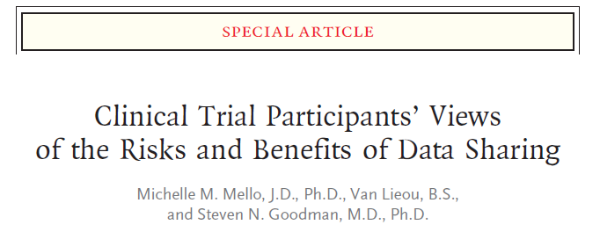
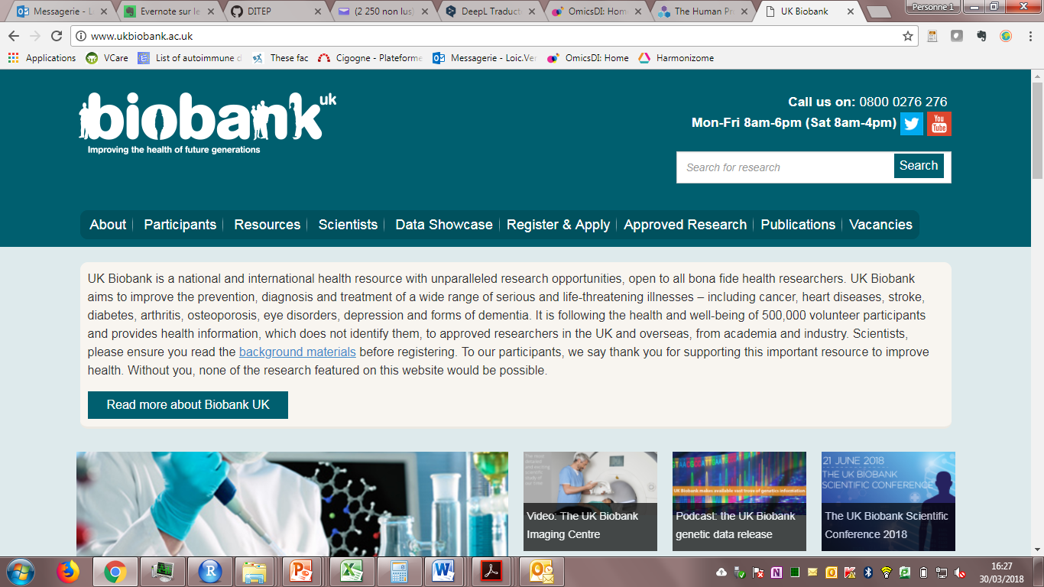
Where are the data?

Slide 42
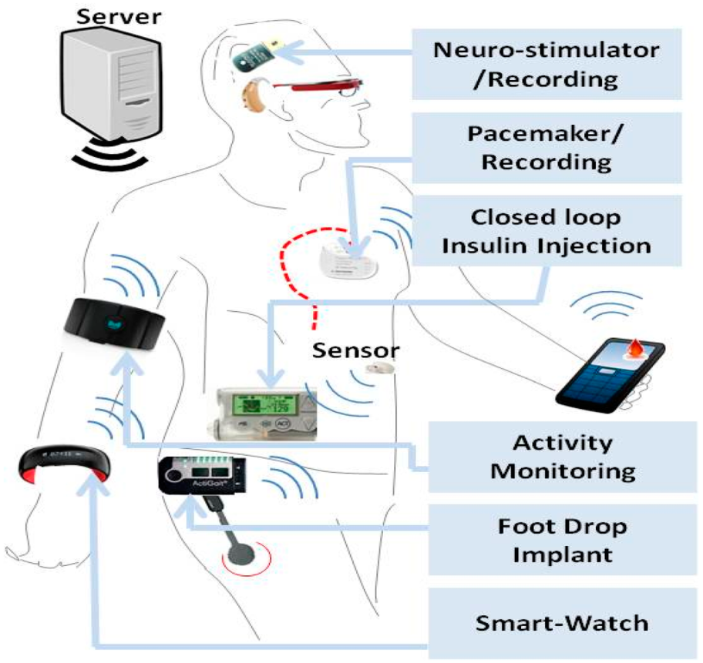
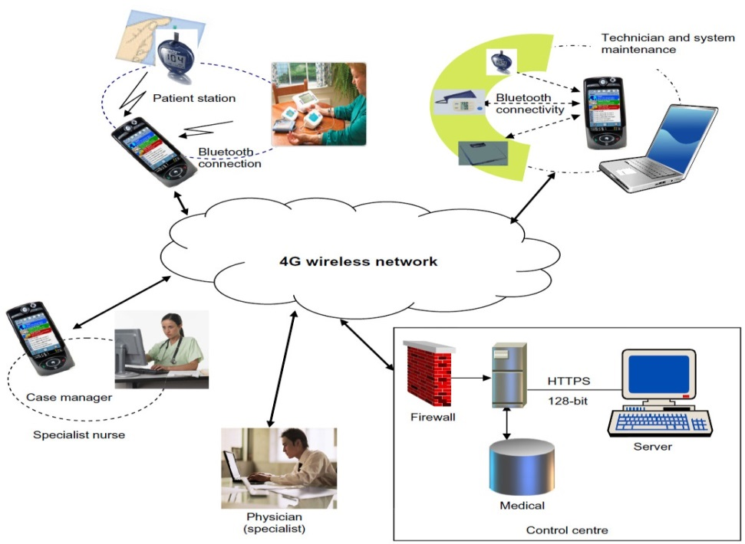
New flow of clinical data

Slide 43
Where are the data?
NOT PUBLIC
DATA
PUBMED
GEO, Array Express
(cell lines & patients) [Micro arrays]
db GAP , db SNP
(cell lines & patients) [DNA seq / RNA seq]
CCLE / GDSC (aka Sanger)
(cancer cell lines)
TCGA + TCIA
(patients data)
PUBLIC
DATA
COHERENT
DATA

Slide 44
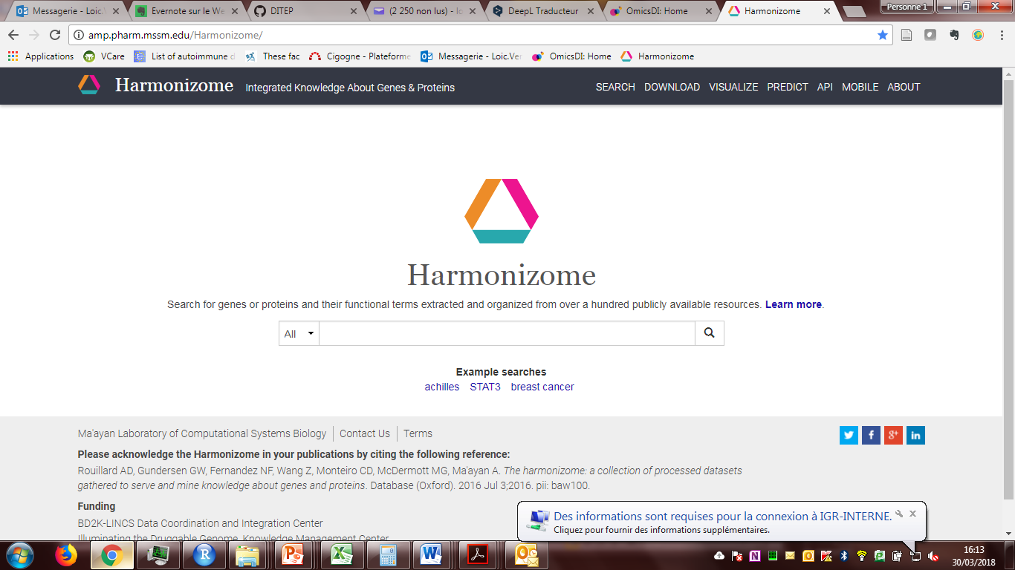

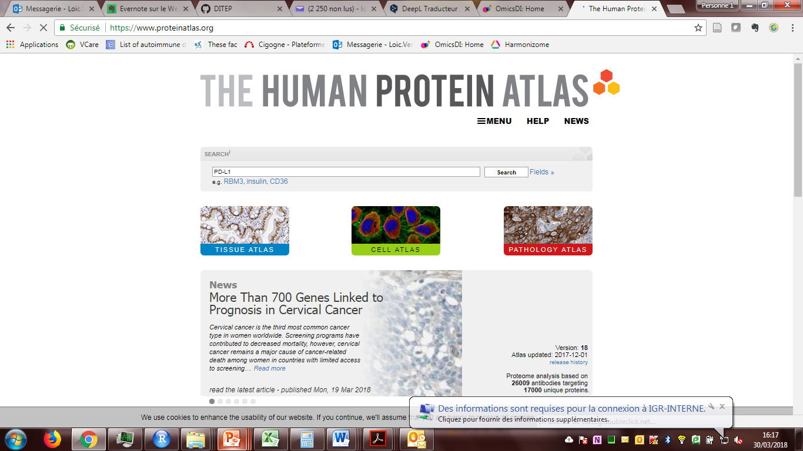
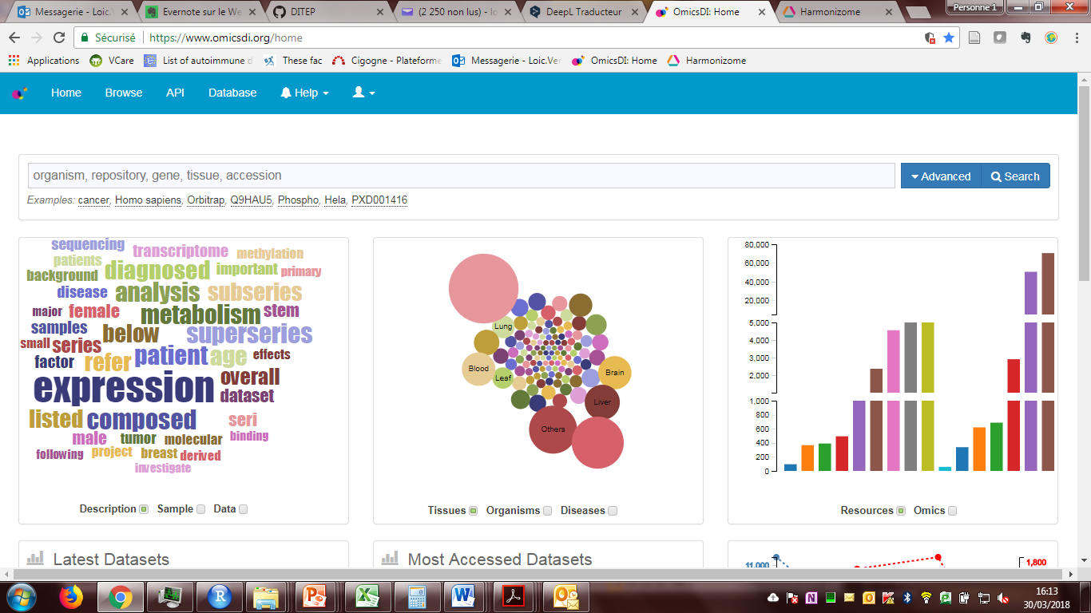
Search is made easy
Traditional databases
Specialized search engine
OmicsDI

Slide 45

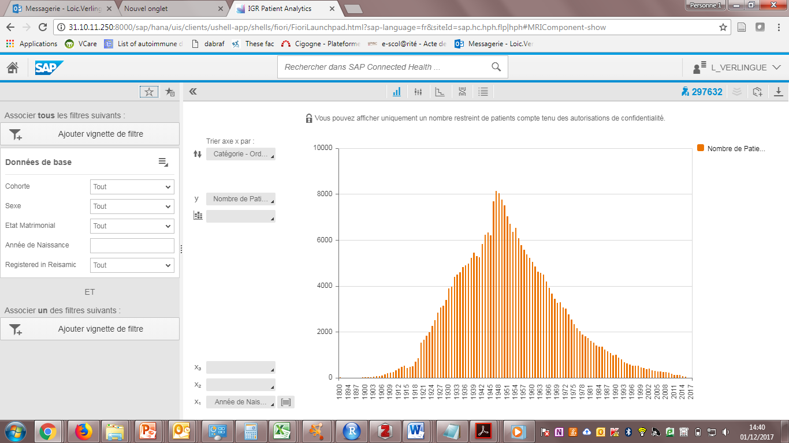
At Gustave Roussy
\\nas-01\SAP-MRI-doc\

Slide 46
Does it work?

Slide 47



Treatment prediction in cell lines
Saez-Rodrigez « predictability is very low »
Costello JC, et al. A community effort to assess and improve drug sensitivity prediction algorithms. Nat Biotechnol. 2014
Francesco Iorio et al, Cell, 2016

Slide 48

Best and most recent try
Treatment prediction in cell lines
Data:
985 cell lines
208 drugs
= 175 603 pairs
Manica M, Oskooei A, Born J, Subramanian V, Sáez-Rodríguez J, Rodríguez Martínez M. Toward Explainable Anticancer Compound Sensitivity Prediction via Multimodal Attention-Based Convolutional Encoders. Mol Pharm. 2019 Oct 31

Slide 49

Treatment prediction in cell lines
Best and most recent try
Test set
Manica M, Oskooei A, Born J, Subramanian V, Sáez-Rodríguez J, Rodríguez Martínez M. Toward Explainable Anticancer Compound Sensitivity Prediction via Multimodal Attention-Based Convolutional Encoders. Mol Pharm. 2019 Oct 31

Slide 50




In 2013
Pronostic estimation the clinic
In 2014
molecular data + clinical variables
improved predictions for 3 / 4 cancers
but gains were limited (2.2-23.9%).
Clinical +
Molecular
Molecular +
Prior knowledge
Molecular
Clinical
Clinical +
Molecular +
Prior knowledge
Bilal E, et al. Improving breast cancer survival analysis through competition-based multidimensional modeling. PLoS Comput Biol. 2013
Yuan Y, et al. Assessing the clinical utility of cancer genomic and proteomic data across tumor types. Nat Biotechnol. 2014
In 2017
In 2018
Adding gene networks information
Using neural networks
Le Morvan M, Zinovyev A, Vert JP. NetNorM: Capturing cancer-relevant information in somatic exome mutation data with gene networks for cancer stratification and prognosis. PLoS Comput Biol. 2017 Jun 26
Ching T, Zhu X, Garmire LX. Cox-nnet: An artificial neural network method for prognosis prediction of high-throughput omics data. PLoS Comput Biol. 2018 Apr

Slide 51

Best and most recent try
Pronostic estimation the clinic
From TCGA
Deep learning with multimodal representation for pancancer prognosis prediction, Anika Cheerla and Olivier Gevaert, Bioinformatics, 35, 2019

Slide 52

Best and most recent try
Pronostic estimation the clinic
Multi-modality test C-index of 0.78
Deep learning with multimodal representation for pancancer prognosis prediction, Anika Cheerla and Olivier Gevaert, Bioinformatics, 35, 2019

Slide 53
How to improve models’ efficacy?
Need more samples (cell lines, organoids)
Need more molecular layers ?
Need better readouts
Need more functional (perturbation) data
Adapt your models to the tasks you want
→ Saez-Rodriguez’s take

Slide 54
How to improve models’ efficacy?
Focus on your data-analytical approaches
Use mechanistic prior knowledge
Adapt your models to the tasks you want
→Camacho, Costello, Collins takes
→ & my take!

Slide 55

“A goal of precision medicine is to stratify patients in order to improve diagnosis and medical treatment”
Haendel MA, Chute CG, Robinson PN. Classification, Ontology, and Precision Medicine. N Engl J Med. 2018 Oct

Slide 56
What is cool about deep learning?
You can play with formalisms & architectures
For what ?
To better fit your data and your questions!
So be innovative!

Slide 57




Find your architecture
Drugs and proteins
to predict bioactivity
→ Multitask NN
Patients’ folder
to predict pateints’ outcome
→ Recurrent neural nets
Molecular data
to predict biological behaviors
→ Graphical networks
Data science team at

Slide 58

Intepretability of ML/DL
?
Mechanistic models?
http://nautil.us/issue/40/learning/is-artificial-intelligence-permanently-inscrutable

Slide 59
For patients’ prognostic estimation
Models are improving…

Slide 60
ML/DL in oncology
"Here's my sequence” The New Yorker
Molecular biology
& pronostic
Drug development
& prediction
Diagnostics
Monitoring patients

Slide 61

The drugs
In development
836
73% with identified targets
2015
Jonsson B, Bergh J. Hurdles in anticancer drug development from a regulatory perspective. Nat Rev Clin Oncol. 2012

Slide 62
The drugs in oncology
Bailly C. Biochem. Pharmacol. 2009, 77, 1447

Slide 63

The drugs in oncology
Development of immuno-oncology drugs - from CTLA4 to PD1 to the next generations.
+ 2nd / 3rd generation TKI
+ very very specific TKI/mAbs

Slide 64



Slide 65

The combinations
Lopez JS, Banerji U. Combine and conquer: challenges for targeted therapy combinations in early phase trials. Nat Rev Clin Oncol. 2017 Jan

Slide 66

The known space
Rifaioglu et al. Recent applications of deep learning and machine intelligence on in silico drug discovery: methods, tools and databases. Brief Bioinform. 2018 Jul 31. PMID: 30084866.

Slide 67

Drug discovery in details
Rifaioglu et al. Recent applications of deep learning and machine intelligence on in silico drug discovery: methods, tools and databases. Brief Bioinform. 2018 Jul 31. PMID: 30084866.

Slide 68

Vamathevan J,. Applications of machine learning in drug discovery and development. Nat Rev Drug Discov. 2019 Apr 11. doi: 10.1038/s41573-019-0024-5. [Epub ahead of print] Review. PubMed PMID: 30976107

Slide 69

Overview
Bioactivity

Slide 70

How to encode drugs
Rifaioglu et al. Recent applications of deep learning and machine intelligence on in silico drug discovery: methods, tools and databases. Brief Bioinform. 2018 Jul 31. PMID: 30084866.

Slide 71

How to encode drugs or proteins?
Notes:
- Extended- connectivity fingerprints (ECFPs) contain information about topological characteristics.
- A Coulomb matrix encodes information about the nuclear charges of a molecule and their coordinates.
- The grid featurizer method incorporates structural features of both the ligand and the target protein as well as the intermolecular forces that
contribute to binding affinity.
Symmetry function is another common encoding of atomic coordinate information, which focuses on the distance between atom pairs and the on angles formed within triplets of atoms.
The graph convolution method computes an initial feature vector and a neighbour list for each atom that summarizes the local chemical
environment of an atom, including atom types, hybridization types and valence structures.
- Weave featurization calculates a feature vector for each pair of atoms in the molecule, including bond properties (if directly connected), graph distance and ring info, forming a feature matrix

Slide 72
How to encode drugs or proteins?
Structure | Descriptors | Proteo-chemometric
From 3D structures available of drugs | From geometrical, structural and physiochemical properties of drugs | Concerns target proteins and ligands
Computationally intensive | One-hot-encoded (binary) matrices | idem
Similarity-based docking methods: less computationally intensive | A well-known example: fingerprints (>100 features) | For proteins: Sequence - UniProt Knowledgebase 3D - Protein Databank–PDB
As efficient & complementary

Slide 73

Gold standard databases
DUD-E
22 886 ligands and their affinities against 102 targets retrieved from the ChEMBL database
TOX-21
12 000 compounds screened for their toxic effects (in bioassays)
MoleculeNet
~ 700 000 compounds retrieved from publicly available databases

Slide 74

Predictions
Rifaioglu et al. Recent applications of deep learning and machine intelligence on in silico drug discovery: methods, tools and databases. Brief Bioinform. 2018 Jul 31. PMID: 30084866.

Slide 75


Deep learning wins
2 studies on multitask NN for bioactivity measures
~ hidden layer sizes: [1000, 2000, 3000]
743 336 compounds & 5069 targets
2.1 million bioactivity measurements
Compounds were represented by 43 x 340 dimensions ECFP12 fingerprints
1.6 million compounds & 259 targets
37.8 million experimental compound–protein interactions
Compounds were represented by ECFP4 fingerprints
J&J + univ Austria 2014
Google + Standford 2015
Unterthiner T, Mayr A, Klambauer G, et al. Deep learning as an opportunity in virtual screening. Deep learn Represent Learn Work NIPS 2014;2014:1–9.
Ramsundar B, Kearnes S, Edu K, et al. Massively Multitask Networks for Drug Discovery. arXiv 2015; arXiv: 1502.02072.

Slide 76
ML/DL in oncology
"Here's my sequence” The New Yorker
Molecular biology
& pronostic
Drug development
& prediction
Free text &
Monitoring patients
Diagnostics

Slide 77

Tasks with EHR
Deep EHR: A Survey of Recent Advances in Deep Learning Techniques for Electronic Health Record (EHR) Analysis. Benjamin Shickel, Patrick J. Tighe, Azra Bihorac, and Parisa Rashidi. arXiv:1706.03446v2

Slide 78

Methods for EHR
Deep EHR: A Survey of Recent Advances in Deep Learning Techniques for Electronic Health Record (EHR) Analysis. Benjamin Shickel, Patrick J. Tighe, Azra Bihorac, and Parisa Rashidi. arXiv:1706.03446v2

Slide 79
Taux d’attrition des patients
1
2
3
4
5
Consultation d’inclusion | Phase de screening | C1J1 | Période de DLT | Sortie d’essai
100% | 85% - 75% |  | ~65% | 0%
 | - (15%, 25%) |  | -16%
 | Screen fails |  | Mortalité
 | Mckane A, et al: Determinants of patient screen failures in Phase 1 clinical trials. Invest New Drugs Kempf E et al: A Case-Control Study Brings to Light the Causes of Screen Failures in Phase 1 Cancer Clinical Trials. PLoS ONE |  | Olmos D, A’hern RP, Marsoni S, et al: Patient selection for oncology phase I trials: a multi-institutional study of prognostic factors. J Clin Oncol

Slide 80



Softwares : prediction of succesful screening and DLT period completion (SSD)
En cours de développement
DITEP Data Science Team
DTNSI

Slide 81

Hierarchical Attention Network
Avantages de ces réseaux :
Mots → Phrases → Document
Contextualisation → Attention
Récurrent → dépendance linguistique

Slide 82

Softwares : prediction of succesful screening and DLT period completion (SSD)
True SSD = 1
True SSD = 0
Predicted SSD = 1
Predicted SSD = 0

Slide 83

AUC

Slide 84



Les résultats d’une phase 1/2 sont-ils généralisables ?
Is this new drug likely to be approved in the future?
drug
Phase 1 abstracts
RESOLVED2
Predicted non-approved:
92% still not approved at 6 yrs
FDA approval free survival (%)
Predicted approved:
73% approved at 6 yrs
Beinse G, Tellier V, Charvet V, et al: Prediction of Drug Approval After Phase I Clinical Trials in Oncology: RESOLVED2. JCO Clinical Cancer Informatics, 2019
https://resolved2.000webhostapp.com/

Slide 85
ML/DL in oncology
"Here's my sequence” The New Yorker
Molecular biology
& pronostic
Drug development
& prediction
Diagnostics
Monitoring patients

Slide 86


Data Science & DITEP
Medical team
Data Science team
loic.verlingue@gustaveroussy.fr
Info https://github.com/DITEP

